Slide 1
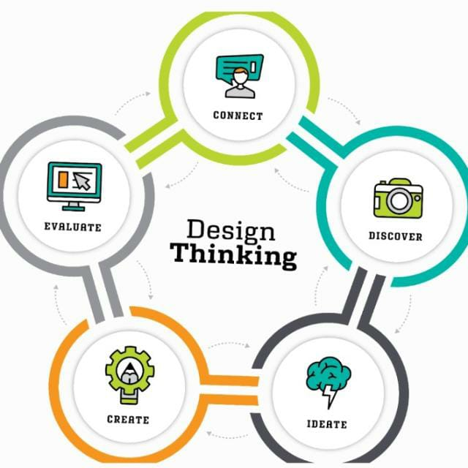
Design thinking and idea lab
Project
DTIL Guidance
Dr. Ajit Muzumdar Sir
Prof. Pravin Chokakkar Sir

Slide 2
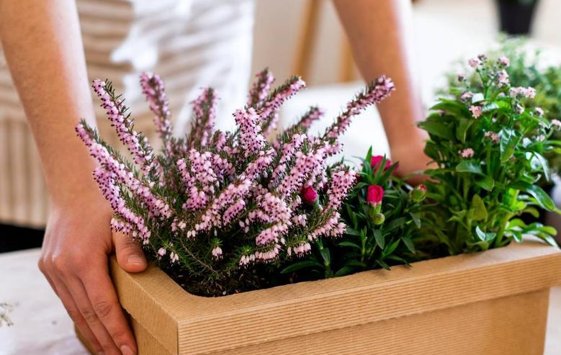
Green Guardians
Guardians Name
Gaurav Bodkhe
Akash Pingale
Kunal Shinde
Rushikesh Parjane
Aditya Pardeshi
Pratik Hirve
Rushikesh Parjane
Aditya Pardeshi
Pratik Hirve

Slide 3
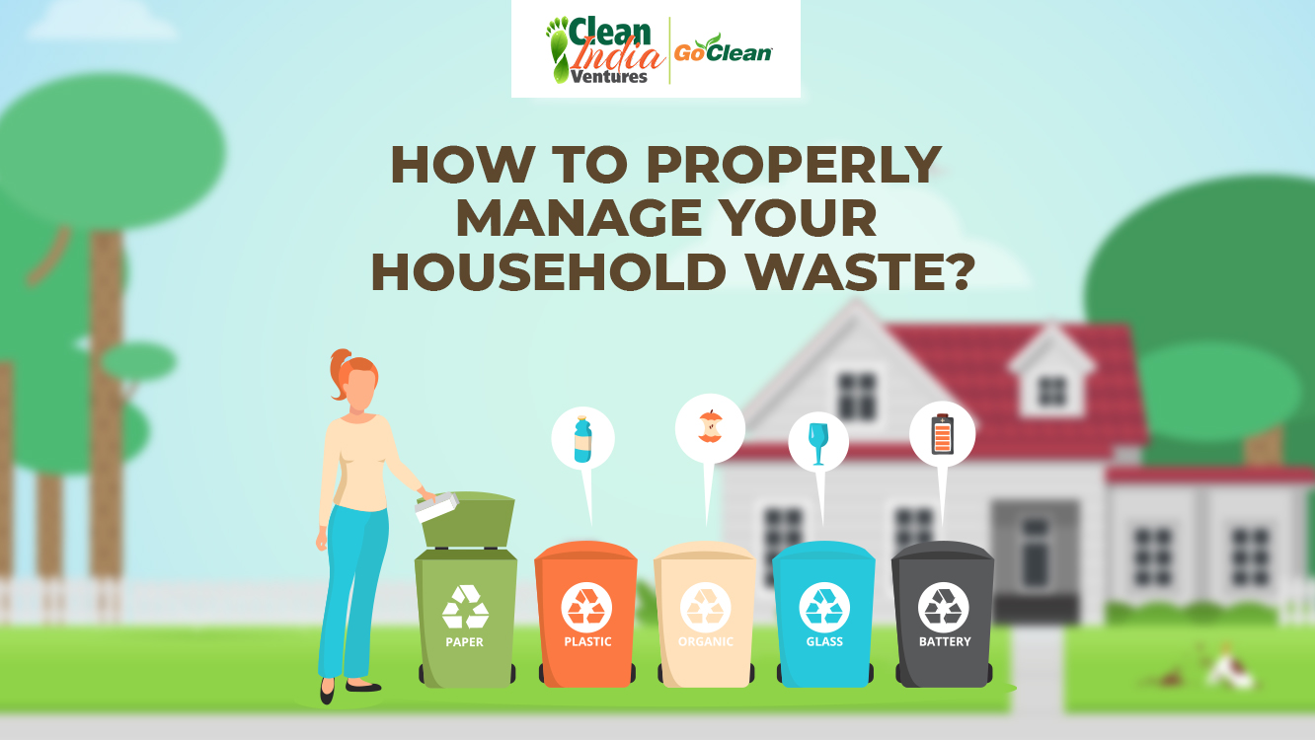
HOUSEHOLD WASTE MANAGEMENT SYSTEM

Slide 4
Problem Statement:
Lack of Awareness about Proper Waste Segregation
The absence of knowledge concerning suitable segregation of wastes results in contamination, health hazards, environmental pollution, and wasted resources. In addition, economic burdens are involved, which prevent effective household waste management..

Slide 5
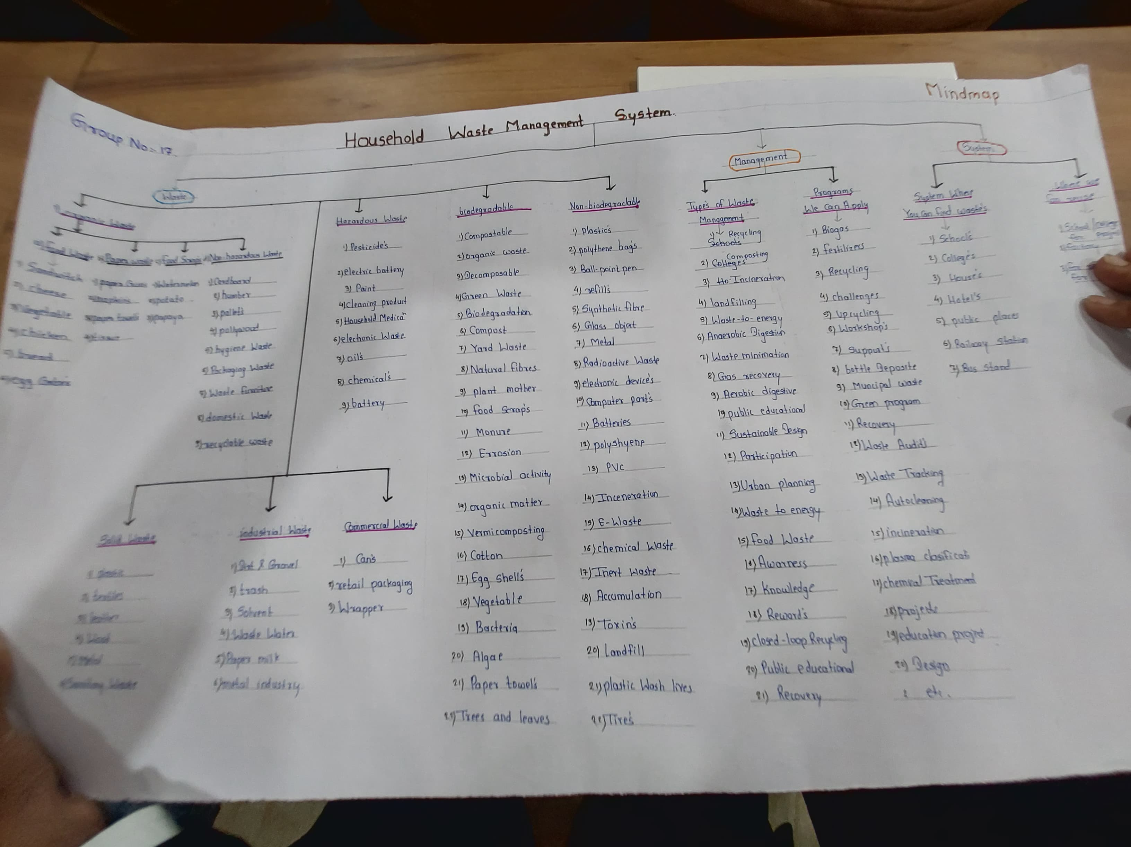
Mind Map

Slide 6
Persona: A persona is a fictional character representation that summarizes key characteristics, needs, and goals of a specific user group, guiding decision-making and design solutions.
End Users of Household Waste Management system:
Household members(family Members, Homeowners)
Recycling facilities members

Slide 7
Persona 1:Family Member(Kavita)
Motivation
Reduce household waste and contribute to a sustainable future.
Teach children about sustainability and responsibility.
To creep their home clean and hygienic.
Background
The Age of Kavita is Around 35yrs.
His occupation is working professional.
He is married woman with two children.
He’s from rural area.
Doubts/Fears
Will the system is easy to use.
Will it take up too much space in the home.
Will the Children actually use it.
Challenges Faced
Difficulty keeping track of what can and cannot be recycled.
Limited storage space for recyclable.
Children often forget to take out the trash/recycling
Aspiration
To reduce her household environmentally inpact.
Aspire to eliminate waste entirely.
To be role model for Children
Story
Kavita is a busy working mom who wants to do her part for the environment she’s tried to implement recycling habits at Home But it’s hard to keep track of what plan and cannot be recycled she’s worried at her children will grow up without understanding the importance of sustainability she’s Dream of a simple and effective way to manage her household waste and teach her children about responsibility
 | Category 1 | Category 2 | Category 3 | Category 4
Item 1 | 4.5 | 2.3 | 1.7 | 5.0
Item 2 | 3.2 | 5.1 | 4.4 | 3.0
Item 3 | 2.1 | 1.7 | 2.5 | 2.8
Item 4 | 4.5 | 2.2 | 1.7 | 7.0

Slide 8
Persona 2:Recycling facility Member(Ryan)
Motivation
Simply household task and reduce effort.
Save money on waste management costs.
Maintain independent and self sufficiency.
Easy to use and manage, saving time and Effort.
Background
Ryan Age around 40.
he is an retired Recycling member
He has no family he is alone.
He is from rural area.
Doubts/Fears
Will the system be easy to use with limited mobility.
Will it be affordable and cost effective.
Can it actually reduced the waste.
Challenges Faced
Physical limitations smake it difficult to take out heavy trash bag
Confusion about what can be recycled
Limited mobility makes it hard toaccess waste management system
Aspiration
To maintain his independence and ability to manage his household.
To reduce his environmental impact and contribute towards sustainable future.
Take charge of reducing waste in their community.
Story
Ryan has Retired A man who values his independence he’ll struggle with taking out the trash and recycling due to physical limitation. He is worried that he will have to rely on the others to help him with household tasks, His dreams of a simple and easy to use System that will allow him to maintain his independence and contribute to a sustainable future.

Slide 9
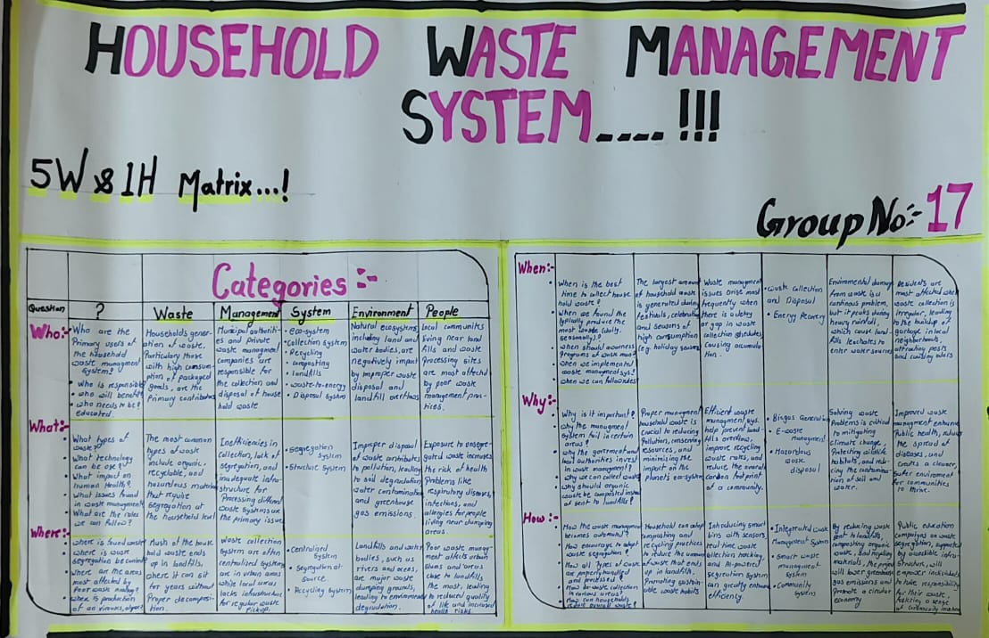
5W1H Matrix (Who, What, Where, When, Why, How)

Slide 10
5W1H Matrix (Who, What, Where, When, Why, How)
When
When to throw away Trash?:After the thing is get Unusable
When to segregate waste?:Immeditely After Generation
When to recycle? :Regularly, as designated by local recycling programs

Slide 11
Where
Where Do we Put The Trash?:designated bins for recycling, organics
Where do we Dipose the Battteries?:At designated recycling center
Where do We Stores The Garbage Bags?:In dry,clean and accessible area

Slide 12
Who
Who Is Responsible For Taking Out the Trash?:Household Members,specially the adults
Who sorts The Recyclables?:Adults & older childrens
Who Empties the compost Bin?: household member, often the gardener or eco-conscious person

Slide 13
Why
Why people are spreading Waste?
Why do we Need To Recycle?
Why Do we Need to Reduced Waste?

Slide 14
What
What are the Disadvantages Of Waste?
What are The Benefits Of Recycling?
What Are the Types Of Waste?

Slide 15
How
How we Manage the Waste?
How do we Recycle The Paper?
How we Can Reduced food Waste?

Slide 16
Theory of Prioritization
The Theory of Prioritization is the method to get to know about the significant problem/idea of your project. It helps you in the both to get to know your problem statement and the idea of your project.
In the Theory of Prioritization all the problems in your project are listed and then they are given with the prioritization values and then the problem with most prioritization value is taken as your most significant problem and this is how you get the both the problem statement and the idea/design of your model.

Slide 17
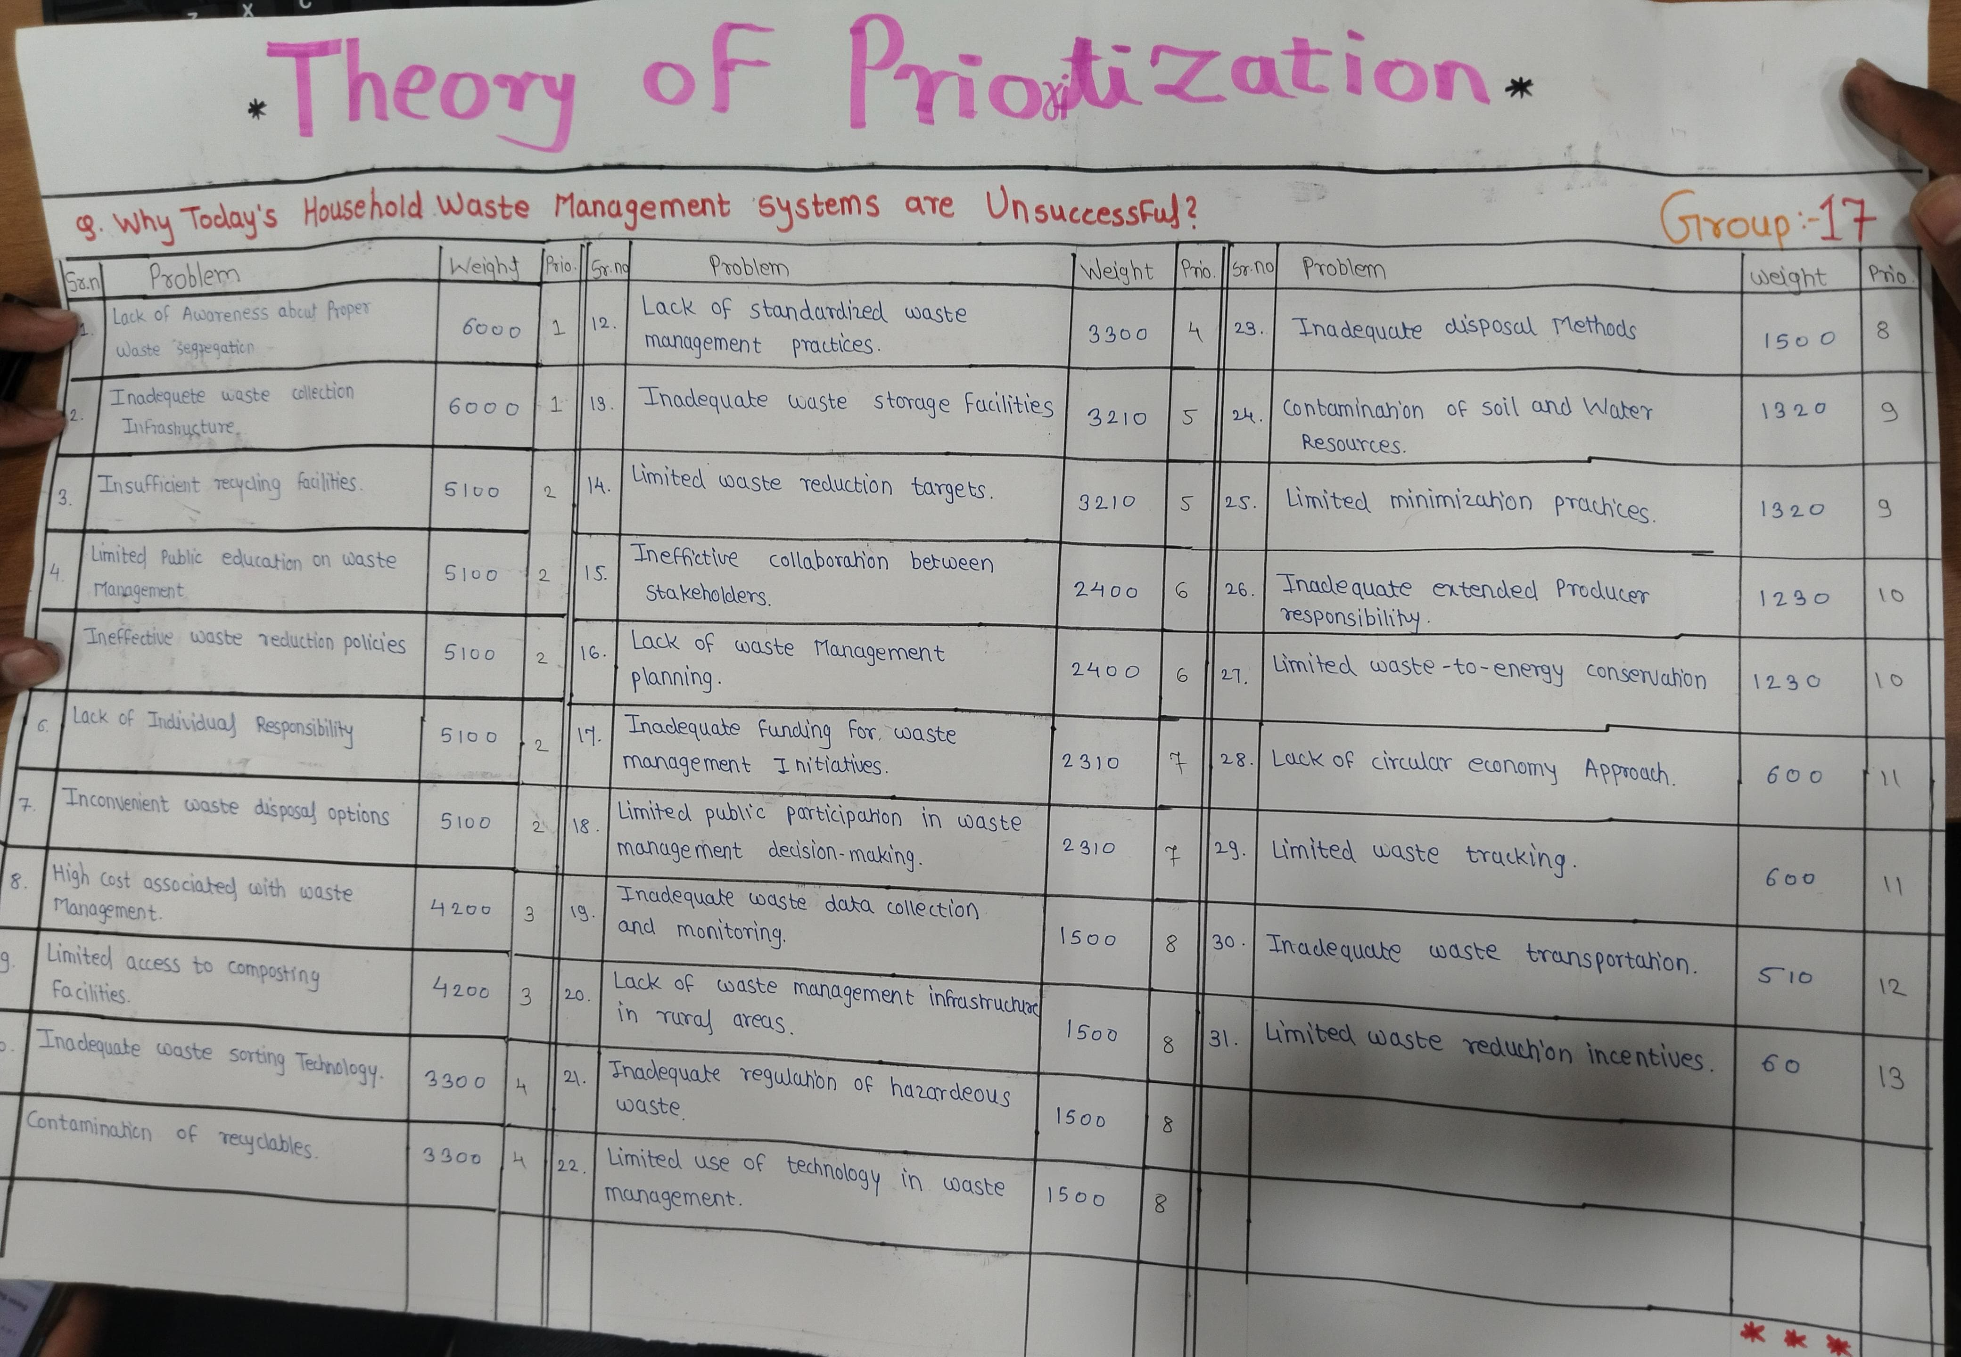
Most Weightage Problem
Lack of Awareness about Proper Waste Segregation

Slide 18
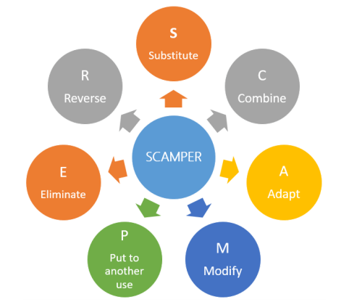
Scamper

Slide 19
Problem:
Lack of Awareness about Proper Waste Segregation
Solution Approach:
Using the "Combine" SCAMPER strategy, this platform unites a website and mobile app to educate all ages on waste management through engaging resources.
Key Features:
Cartoon Videos for Children:Story-driven characters promoting recycling & sustainability.
Inspirational Videos for All Ages:Success stories and practical actions for positive impact.

Slide 20

Rules & Regulations Section: Local waste laws and recycling guidelines.
Impact : An accessible, interactive platform to raise awareness, inspire eco-friendly behaviour, and foster sustainable waste practices.
Impact on Social Media
Encourages sharing of content, creating a ripple effect in awareness.

Slide 21
Journey Map
A Common Man=Abhi
He Collect the Waste
Manage the Waste
He did’t Find recycling Faculty
He Meets a helpful person who know about household management
He finding The Various tool 's for managing the waste
He visiting the Mobile App
He doing the Process for Login in App
He first time Fail to log in
After Some Time Successfully Log in
He searching Information for Managing the waste
He get information to managing the Waste
He wants to Transport Waste from one place to another Place
He Searching Transport Vehicle
He Find that searching Transport Vehical
7
Expression
6
11
4
6
14
10
9
2
12
8
5
1
13
Event
2
-2
3
4
-4
-6
Notes:
512
12
12
5

Slide 22
Waste Collection Member=Sunil
Collect Waste from Surrounding
Managing the Waste
The recycling Van not come on time
He Finding the way to Manage it
He Call her Friend For help & he give suggestion to use app
He visit the Mobile App
He Doing the Process For log in
Due to Wrong Number, he fail
He Successfully log in
He Searching information About managing the Waste
He get information for how to Segregate Waste
He Wants to They Show Nearby recycling Facilities
He Did not find that a location of Recycling Van
He Understand All the things
7
6
11
4
6
9
10
14
2
5
13
12
1
8
-2
2
4
-4
3
-6

Slide 23
App Presentation

